Slide 1
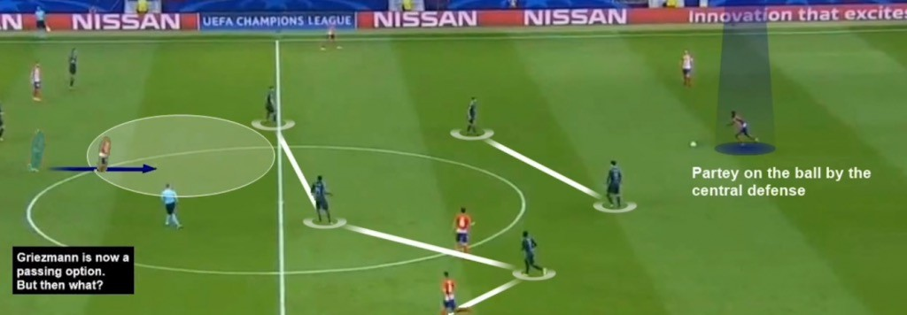
SPORTS ANALYTICS
Brøndby AS

Slide 2
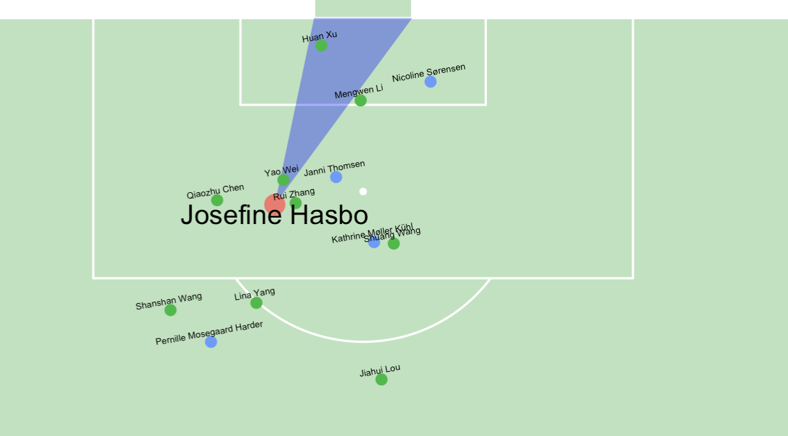
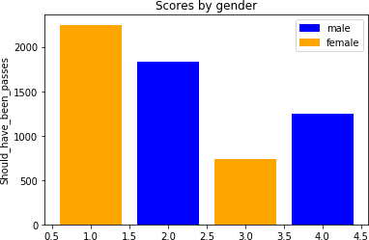
Agenda
Intro til Fodbold
Danmark-RSA
Neymar-Mbappe
Overview Statsbomb
lineups
events
matches
Events – shots
import fra statsbomb
all shots one match
one shot – position
ggsoccer
all shots – position and arrow
one shot - freezeframe

Slide 3
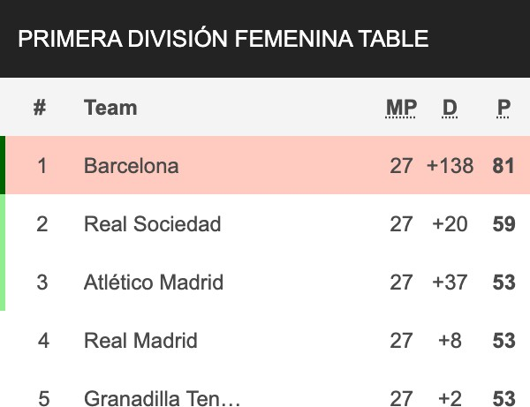
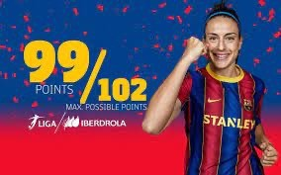

Kvinder & Fodbold
Kvinder vs mænd?
længden af afleveringer antal frispark
antal skud
antal lange afleveringer antal boldtab hastighed på skud

Slide 4
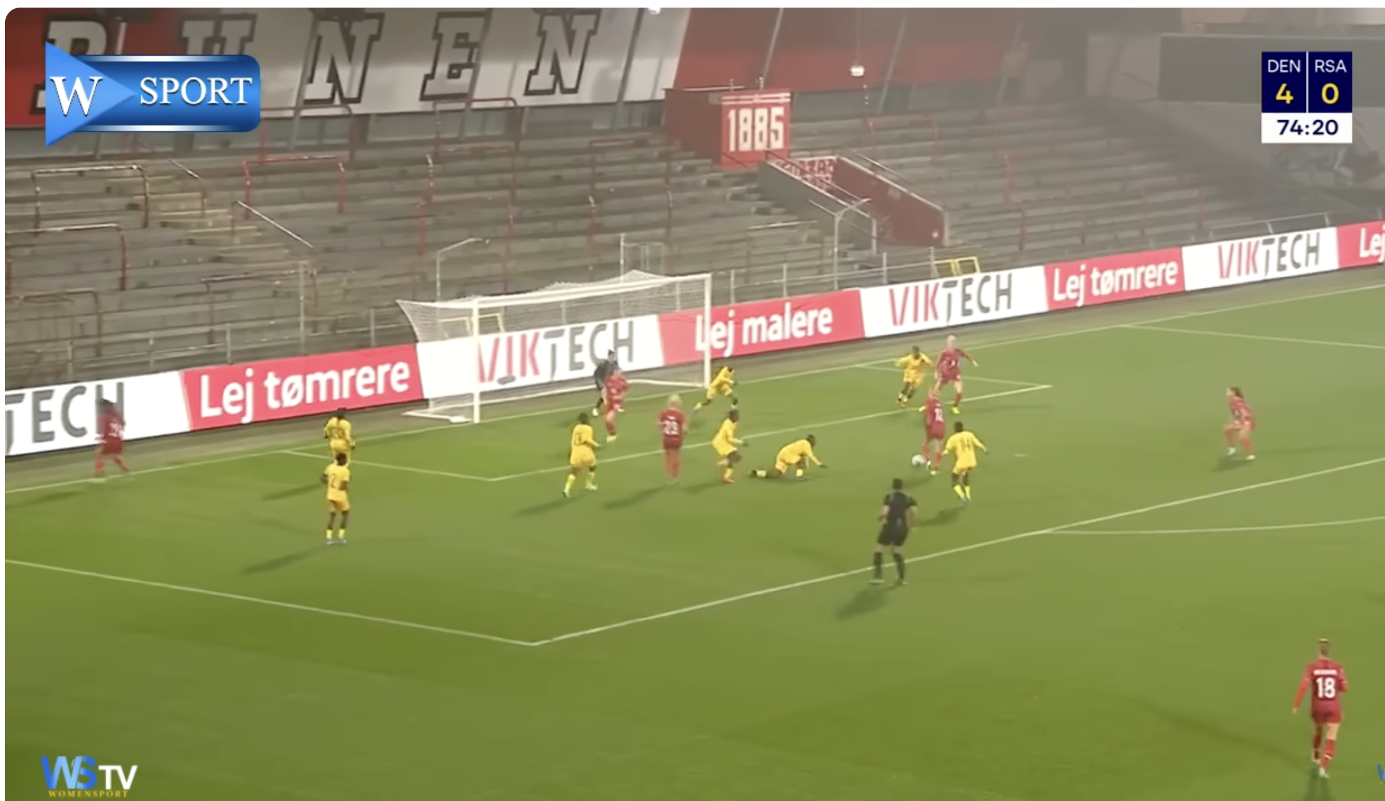
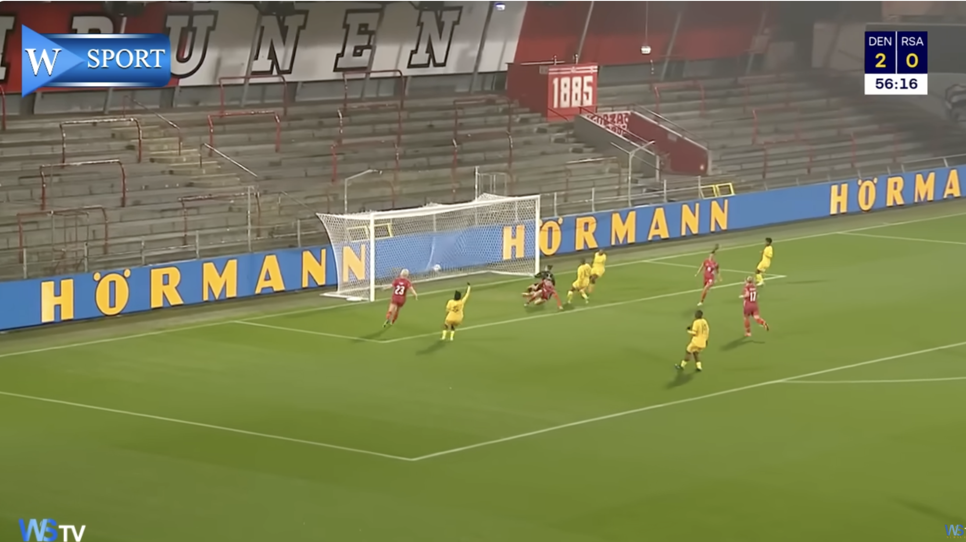
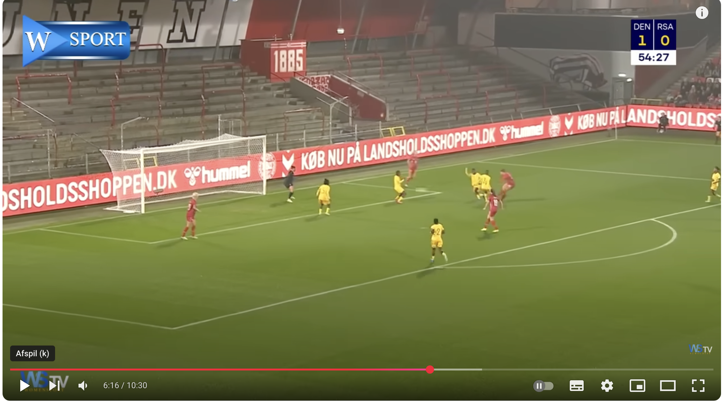
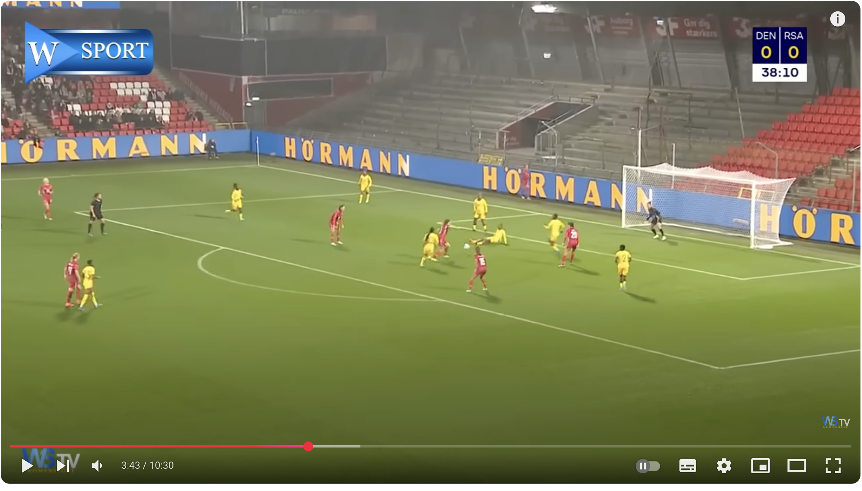
Kvinder & Fodbold

Slide 5
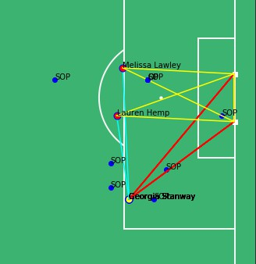
Kvinder & Fodbold
Freeze-Frame
Number of players in tri
Distance of pass to teamplayer
Distance to passline from opponent
Teamplayer xG
Distance, angle
This frame:
GS:2 in tri and gdist 24.0
ML: 2 in tri and gdist 18.6 LH: 1 in tri and gdist 19.2 GS to ML: 22
GS to LH: 14
Closest OPP to ML-pass: 2.72 / 0.12 Closest OPP to LH-pass: 2.12 / 0.15
If for all team-others shooter tri < other tri AND
Other gdist < (shooter + tol) AND
Passdist Shooter-Other-ratio > 0.2
Then
should have been a pass
Conlusion: Should have been a pass

Slide 6
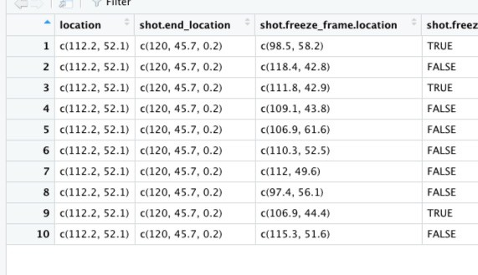
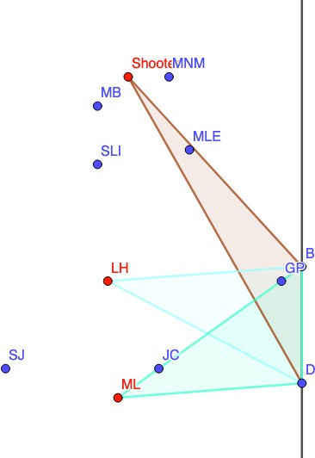
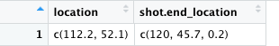
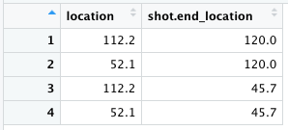
Kvinder & Fodbold
Find all non-teammates For each teammate
compute number of nont in triangle

Slide 7
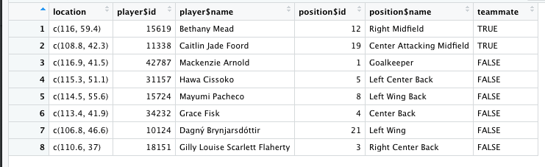
Kvinder & Fodbold
Find all non-teammates For each teammate
compute number of nont in triangle

Slide 8
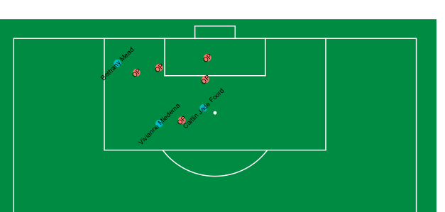
Kvinder & Fodbold

Slide 9
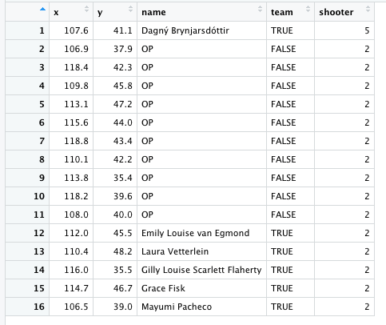
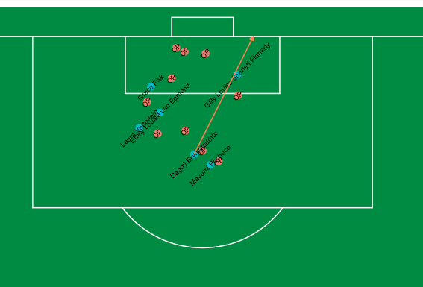
Kvinder & Fodbold

Slide 10
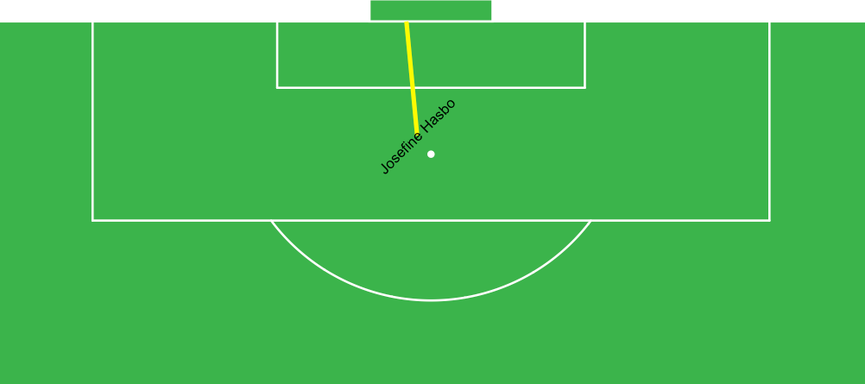
Kvinder & Fodbold
Single shot

Slide 11
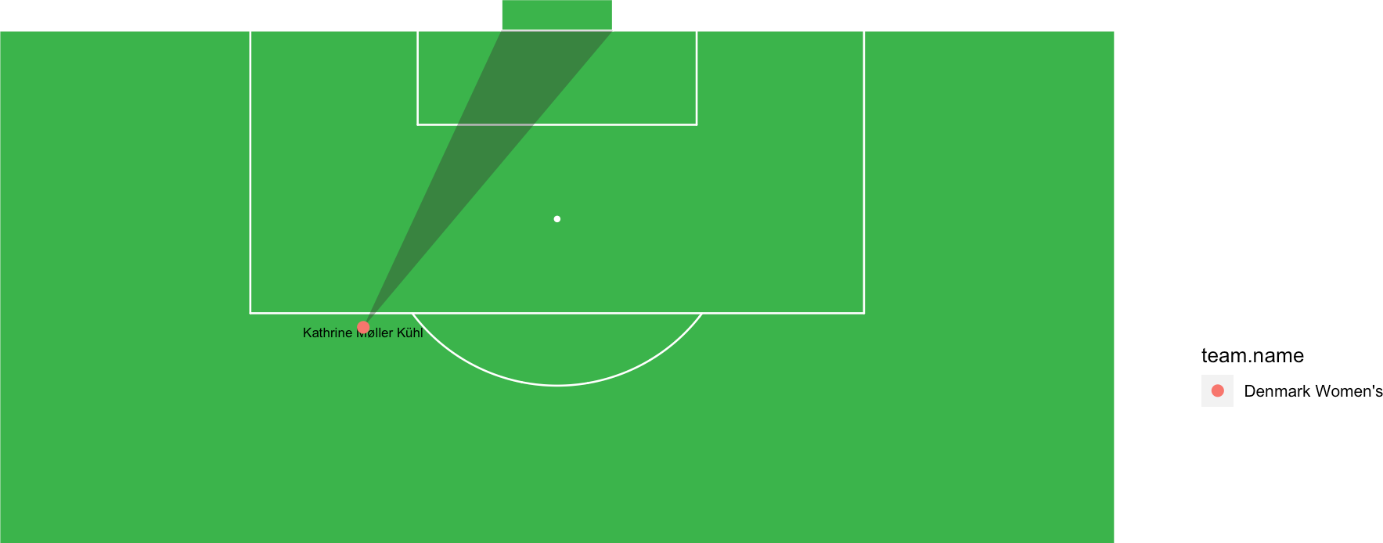
Kvinder & Fodbold
Single shot - tri

Slide 12
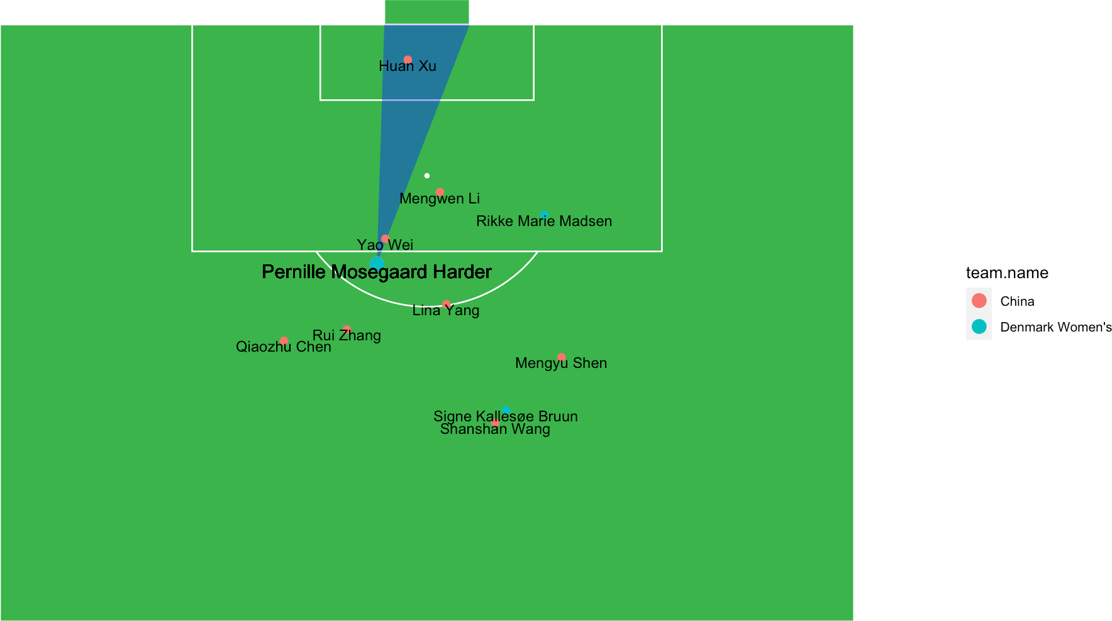
Kvinder & Fodbold Freeze Frame case

Slide 13
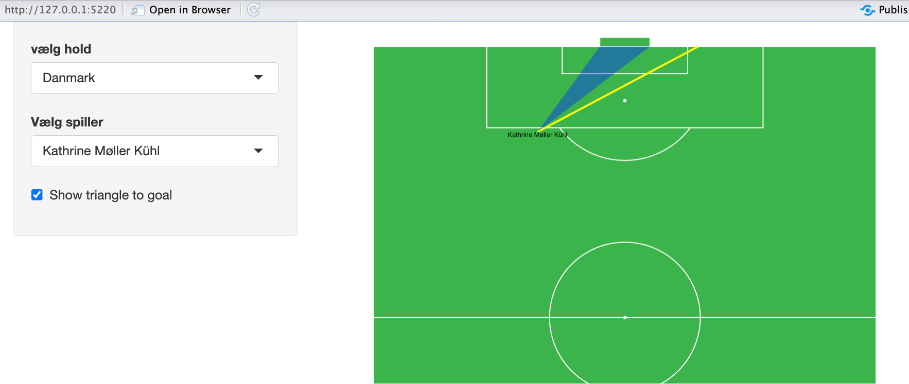
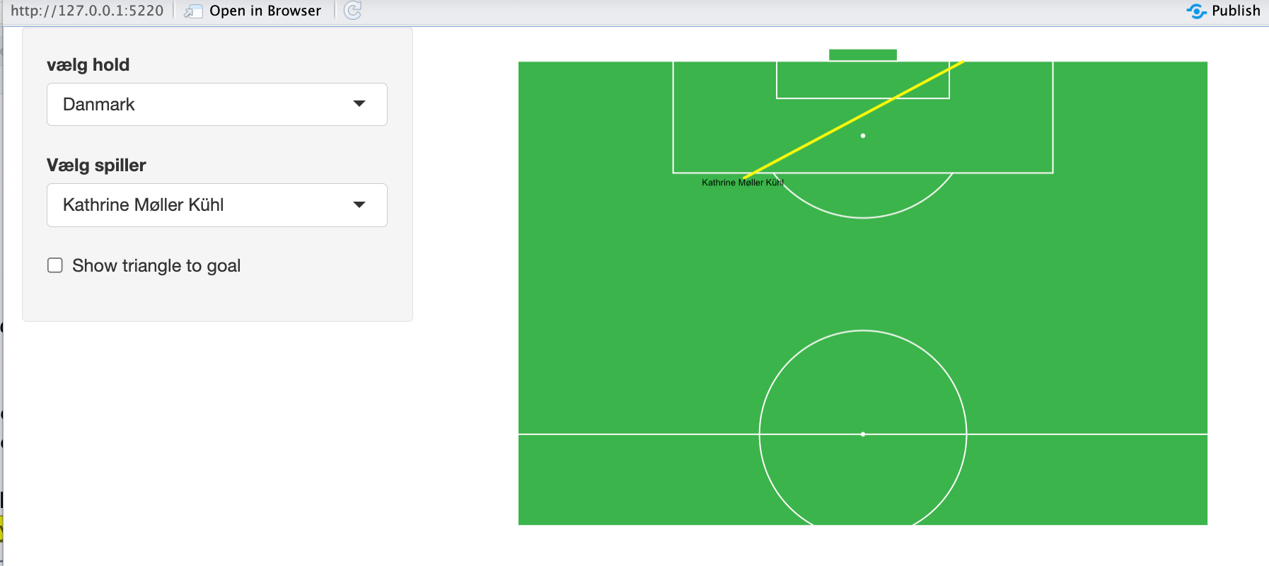
Kvinder & Fodbold
Lav denne Shiny-app ud fra Statsbombdata (Danmark-Kina). den skal indeholde flg commits:
ui-template
spiller-element populeret dynamisk
server-output med ggplot
uden trekant
ui-element checkbox tilføjet
server-output med ggplot som afhænger af checkbox

Slide 14
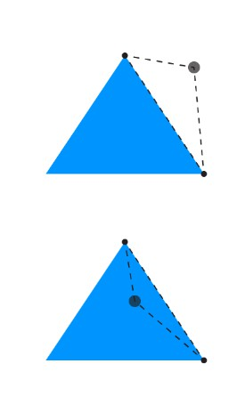
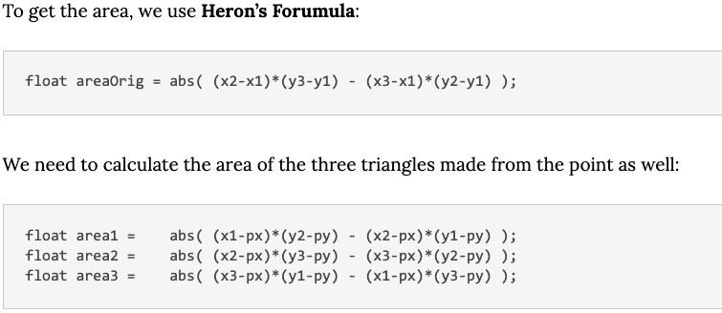
Freeze-Frame math
Number of players in tri

Slide 15
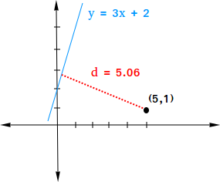
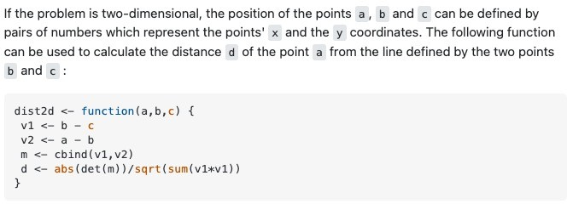
Freeze-Frame – pass possible?
Distance to passline from opponent

Slide 16
Kvinder & Fodbold
Bias ..
find({"type.name":"Shot", "gender":"female", "position.id" : {"$in":striker_player}})
find({"type.name":"Shot", "gender":"male",
"position.id" : {"$in":def_player}})

Slide 17


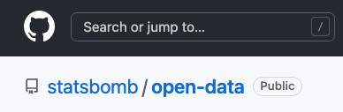
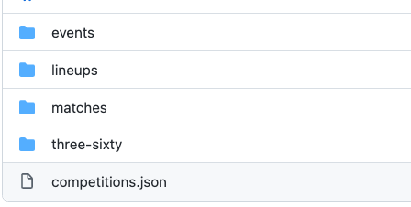
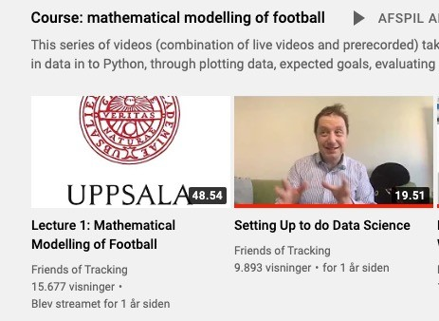

Slide 18
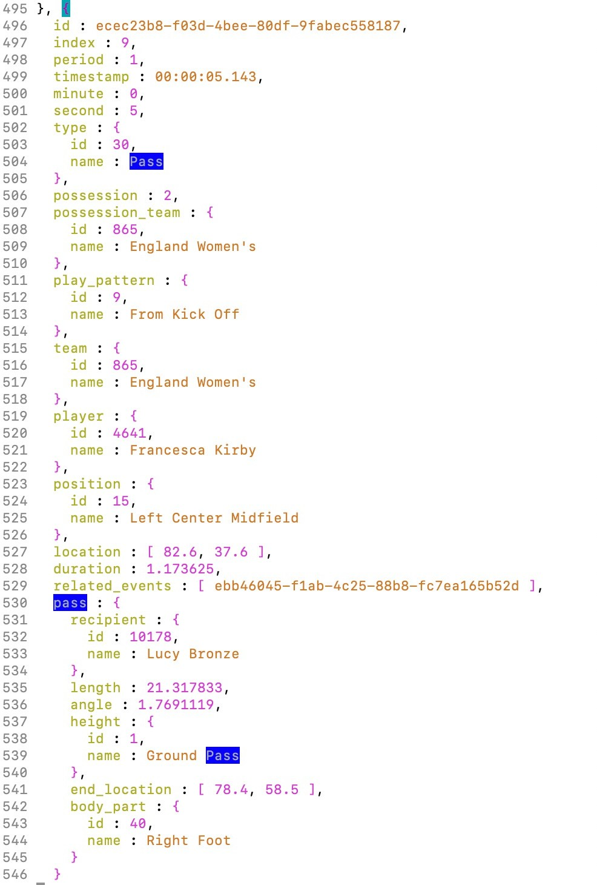
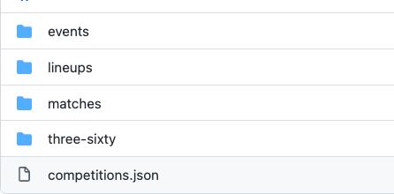
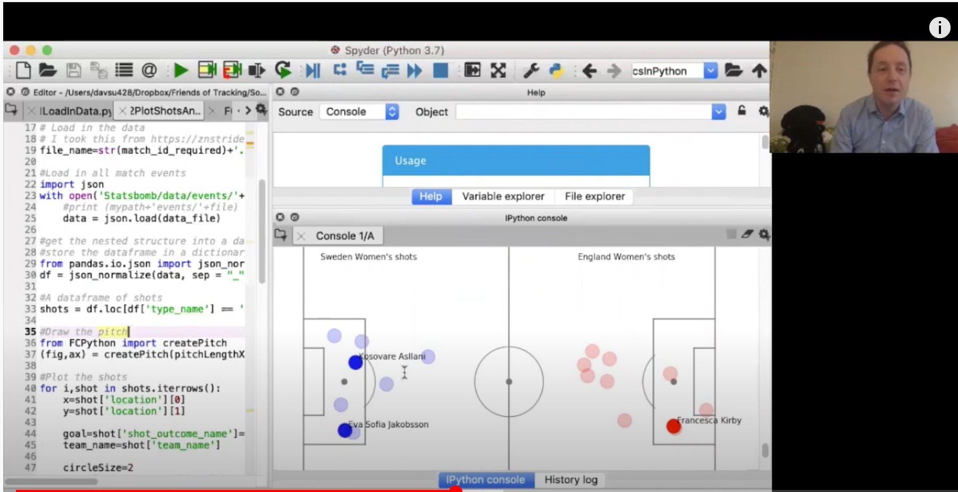
Sample event from 69301.json with 3291 events
David laver
Shots map
Passes map

Slide 19
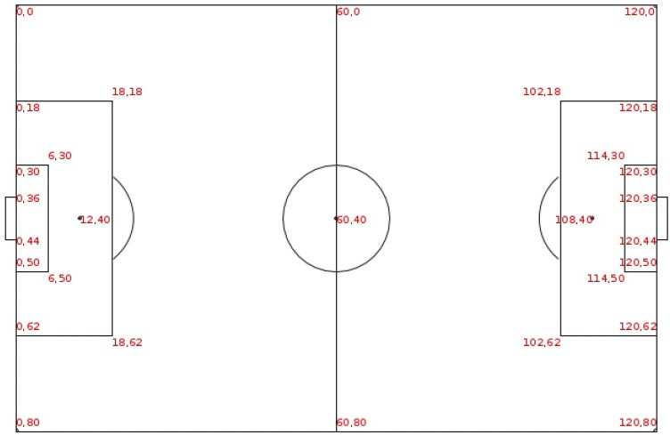

Slide 20
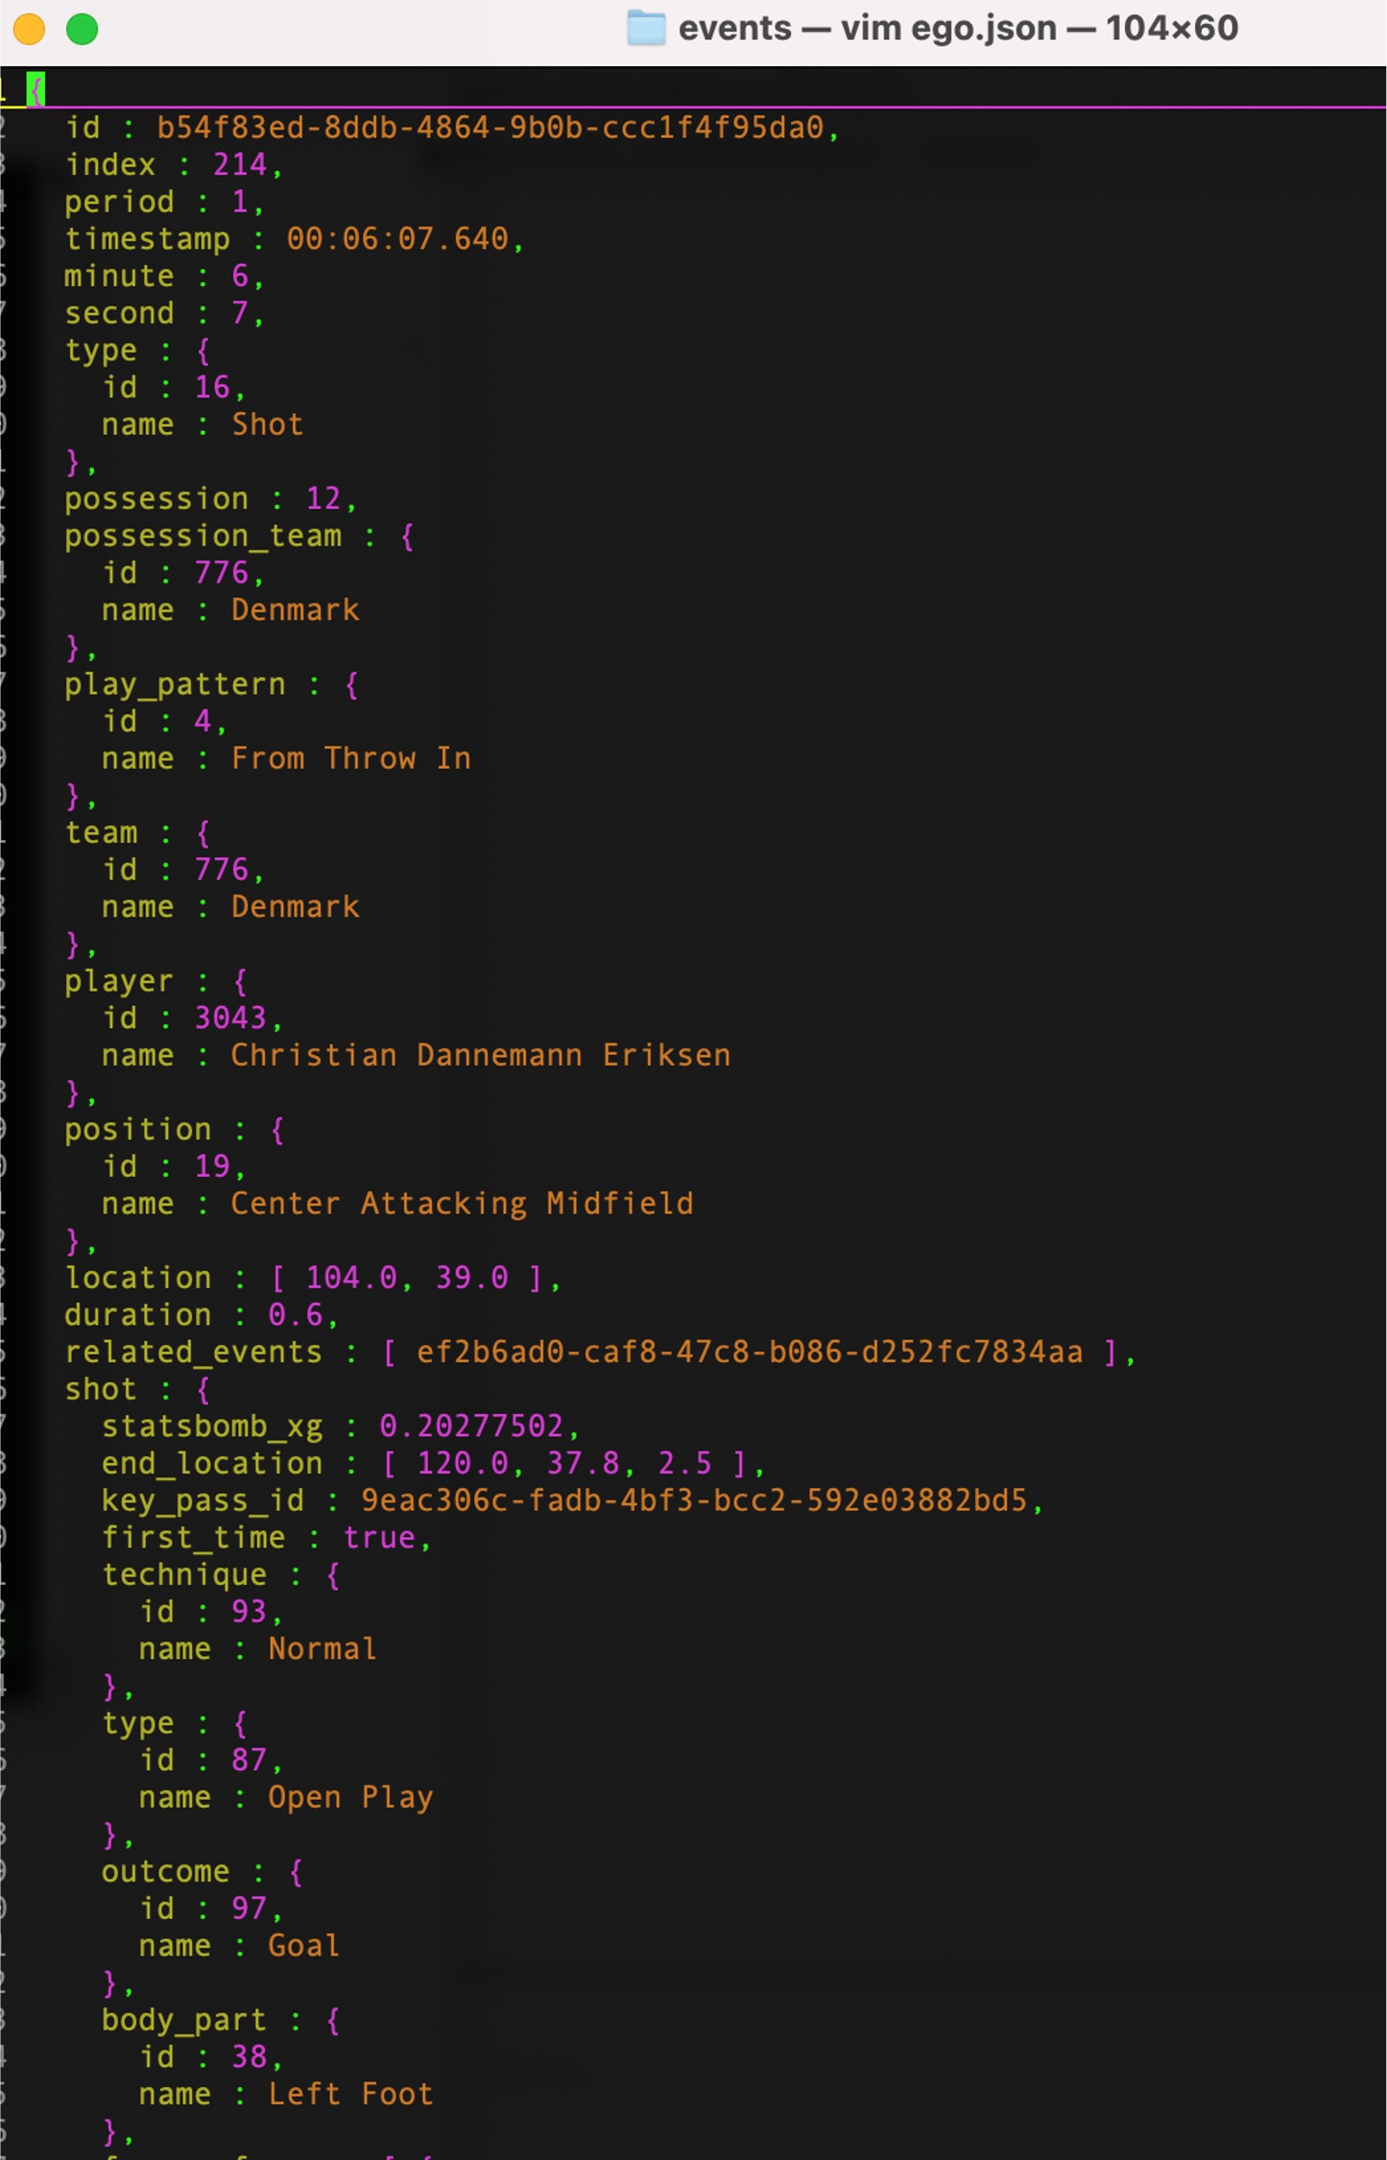
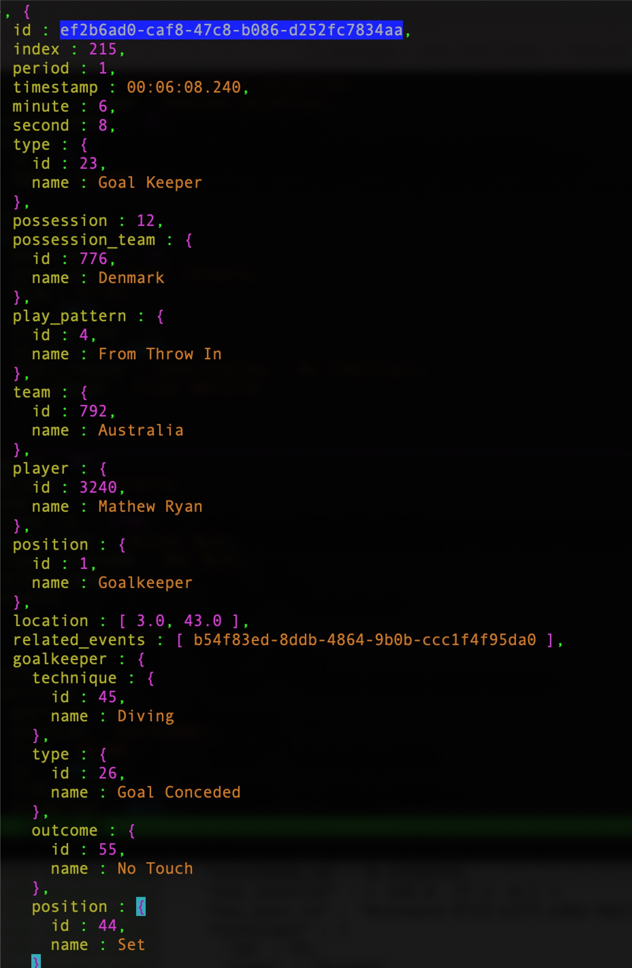
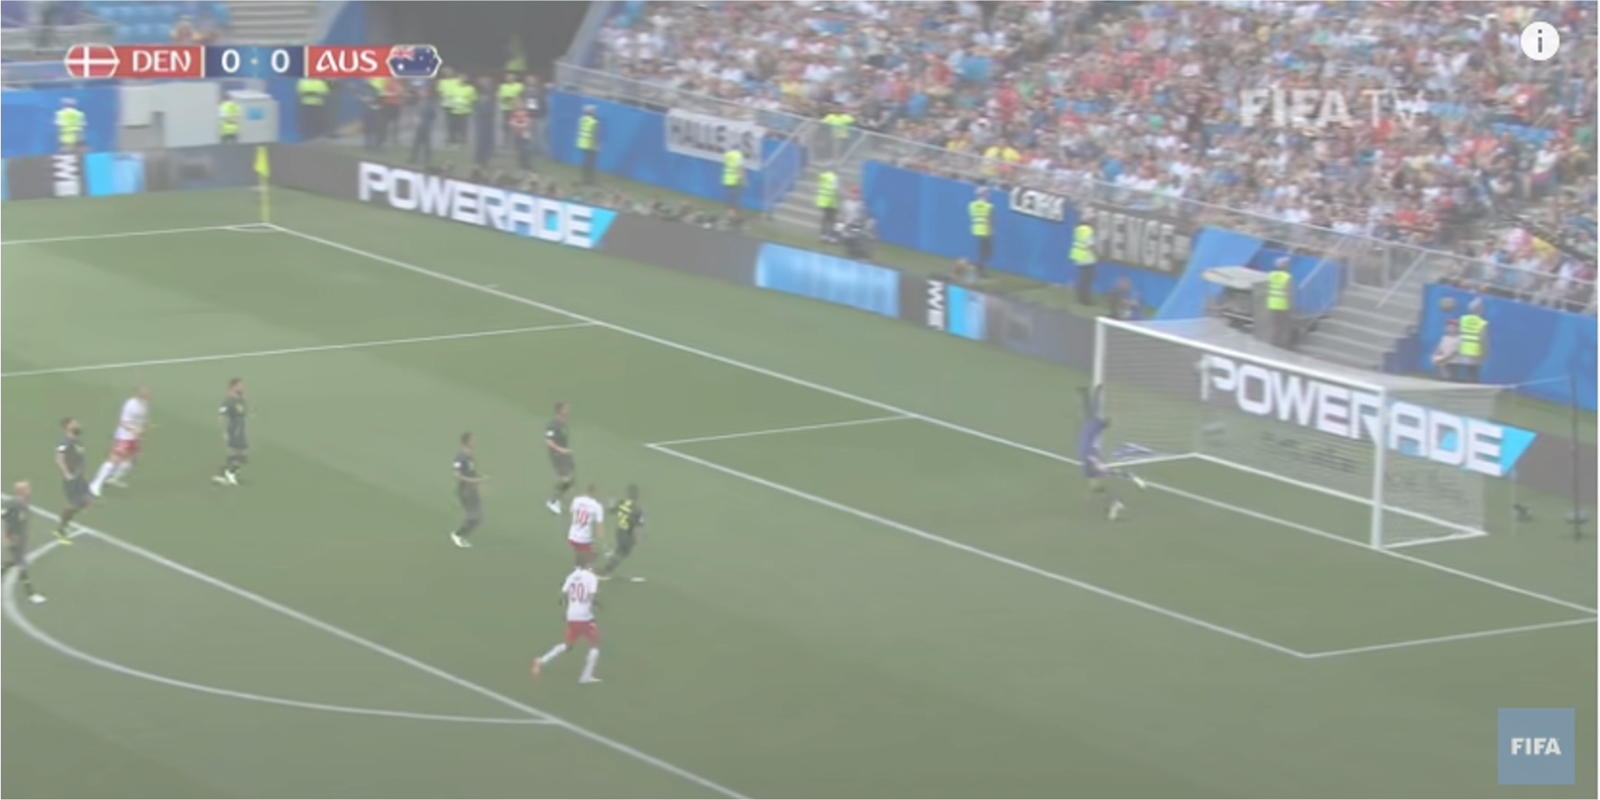

7547.json
7547.json

Slide 21
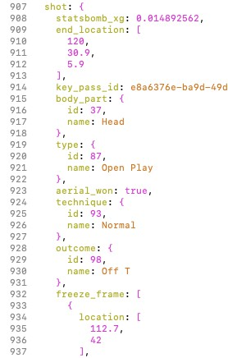
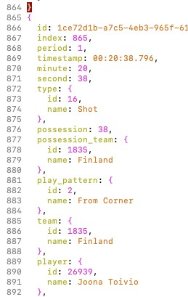
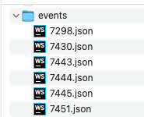
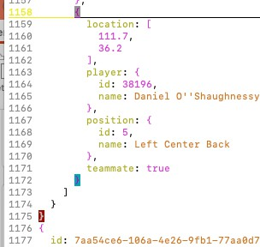
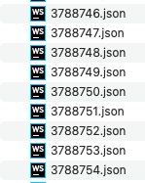
3788753.json – eksempel på skud-event.

